Slide 1
Informed Search and Exploration Part III
Instructor: Dr. Wei Ding

Slide 2
Local Minima Problem
Question: How do you avoid this local minimum?
barrier to local search
starting
point
descend
direction
local minimum
global minimum

Slide 3
Consequences of the Occasional Ascents
desired effect
Help escaping the
local optima.
adverse effect
Might pass global optima
after reaching it
(easy to avoid by
keeping track of
best-ever state)

Slide 4
Boltzmann machines
h
The Boltzmann Machine of
Hinton, Sejnowski, and Ackley (1984)
uses simulated annealing to escape local minima.
To motivate their solution, consider how one might get a ball-bearing traveling along the curve to "probably end up" in the deepest minimum. The idea is to shake the box "about h hard" — then the ball is more likely to go from D to C than from C to B. So, on average, the ball should end up in C's valley.

Slide 5
Simulated annealing: basic idea
From current state, pick a random successor state;
If it has better value than current state, then “accept the transition,” that is, use successor state as current state;
Otherwise, do not give up, but instead flip a coin and accept the transition with a given probability (that is lower as the successor is worse).
So we accept to sometimes “un-optimize” the value function a little with a non-zero probability.

Slide 6
Simulated annealing
Kirkpatrick et al. 1983:
Simulated annealing is a general method for making likely the escape from local minima by allowing jumps to higher energy states.
The analogy here is with the process of annealing used by a craftsman in forging a sword from an alloy.

Slide 7
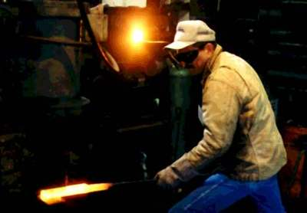
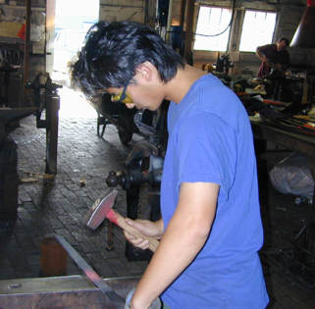
Real annealing: Sword
He heats the metal, then slowly cools it as he hammers the blade into shape.
If he cools the blade too quickly the metal will form patches of different composition;
If the metal is cooled slowly while it is shaped, the constituent metals will form a uniform alloy.

Slide 8
Simulated annealing in practice
Geman & Geman (1984): if temperature T is lowered sufficiently slowly (with respect to the number of iterations used to optimize at a given T), simulated annealing is guaranteed to find the global minimum.
Caveat: this algorithm has no end (Geman & Geman’s T decrease schedule is in the 1/log of the number of iterations, so, T will never reach zero), so it may take an infinite amount of time for it to find the global minimum.

Slide 9
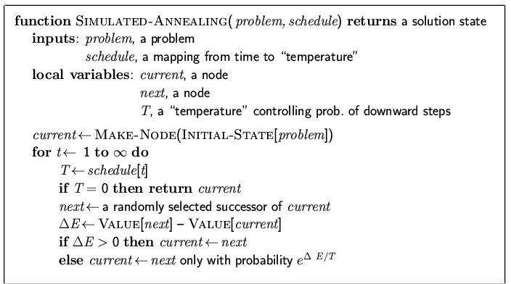
Simulated annealing algorithm
Idea: Escape local extreme by allowing “bad moves,” but gradually decrease their size and frequency.
Note: goal here is to
maximize E.
-exp(ΔE/T)
ΔE<0
If the goal is to minimize E.

Slide 10
Boltzmann distribution
At thermal equilibrium at temperature T, the
Boltzmann distribution gives the relative
probability that the system will occupy state A vs.
state B as:
where E(A) and E(B) are the energies associated with states A and B.

Slide 11
Note on simulated annealing: limit cases
Boltzmann distribution: accept “bad move” with ΔE<0 (goal is to maximize E) with probability P(ΔE) = exp(ΔE/T)
If T is large: ΔE < 0
ΔE/T < 0 and very small
exp(ΔE/T) close to 1
accept bad move with high probability
If T is near 0: ΔE < 0
ΔE/T < 0 and very large
exp(ΔE/T) close to 0
accept bad move with low probability
Random walk
Deterministic
down-hill

Slide 12
Simulated annealing
Different from hill climbing, simulated annealing picks a random move.
If the move improves the situation, it is always accepted. Otherwise, the algorithm accepts the move with some probability less than 1.
The probability decreases exponentially with the “badness” of the move – the amount ΔE by which the evaluation is worsened.
“bad” moved are more likely to be allowed at the start when temperature is high, and they become more unlikely as T decreases.
Simulated annealing is used extensively to solve VLSI layout problems, factory scheduling.

Slide 13
Simulated Annealing Steps
Step 1: Initialize – Start with a random initial placement. Initialize a very high “temperature”.
Step 2: Move – Perturb the placement through a defined move.
Step 3: Calculate score – calculate the change in the score due to the move made.
Step 4: Choose – Depending on the change in score, accept or reject the move. The prob of acceptance depending on the current “temperature”.
Step 5: Update and repeat– Update the temperature value by lowering the temperature. Go back to Step 2.
The process is done until “Freezing Point” is reached.

Slide 14
Algorithm for placement
Algorithm SIMULATED-ANNEALING
Begin
temp = INIT-TEMP;
place = INIT-PLACEMENT;
while (temp > FINAL-TEMP) do
while (inner_loop_criterion = FALSE) do
new_place = PERTURB(place);
ΔC = COST(new_place) - COST(place);
if (ΔC < 0) then
place = new_place;
else if (RANDOM(0,1) > e^{-(ΔC/temp)}) then
place = new_place;
temp = SCHEDULE(temp);
End.

Slide 15
Convergence of simulated annealing

Slide 16
Qualitative Analysis
Randomized local search.
Is simulated annealing greedy?
Controlled greed.
Once-a-while exploration.
Is a greedy algorithm better? Where is the difference?
The ball-on-terrain example.

Slide 17
Ball on terrain example – Simulated Annealing vs Greedy Algorithms
The ball is initially placed at a random position on the terrain. From the current position, the ball should be fired such that it can only move one step left or right.What algorithm should we follow for the ball to finally settle at the lowest point on the terrain?

Slide 18
Ball on terrain example – SA vs Greedy Algorithms

Slide 19
Applications
Circuit partitioning and placement.
Strategy scheduling for capital products with complex product structure.
Umpire scheduling in US Open Tennis tournament!
Event-based learning situations.

Slide 20
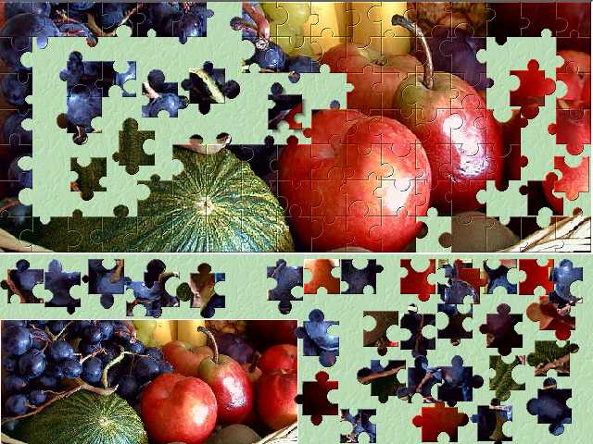
Jigsaw puzzles – Intuitive usage of Simulated Annealing
Given a jigsaw puzzle such that one has to obtain the final shape using all pieces together.
Starting with a random configuration, the human brain unconditionally chooses certain moves that tend to the solution.
However, certain moves that may or may not lead to the solution are accepted or rejected with a certain small probability.
The final shape is obtained as a result of a large number of iterations.

Slide 21
Conclusions
Simulated Annealing algorithms are usually better than greedy algorithms, when it comes to problems that have numerous locally optimum solutions.
Simulated Annealing is not the best solution to circuit partitioning or placement. Network flow approach to solving these problems functions much faster.
Simulated Annealing guarantees a convergence upon running sufficiently large number of iterations.

Slide 22
Local beam search
Keep track of k states rather than just one
Start with k randomly generated states
At each iteration, all the successors of all k states are generated
If any one is a goal state, stop; else select the k best successors from the complete list and repeat.
In a local beam search, useful information is passed among the k parallel search threads.
The algorithm quickly abandons unfruitful searches and moves its resources to where the most progress is being made.

Slide 23
Summary
Best-first search = general search, where the minimum-cost nodes (according to some measure) are expanded first.
Greedy search = best-first with the estimated cost to reach the goal as a heuristic measure.
- Generally faster than uninformed search
- not optimal
- not complete.
A* search = best-first with measure = path cost so far + estimated path cost to goal.
- combines advantages of uniform-cost and greedy searches
- complete, optimal and optimally efficient
- space complexity still exponential

Slide 24
Summary
Time complexity of heuristic algorithms depend on quality of heuristic function. Good heuristics can sometimes be constructed by examining the problem definition or by generalizing from experience with the problem class.
Local search methods can get stuck in local extreme; simulated annealing provides a way to escape local extreme, and is complete and optimal given a slow enough cooling schedule.

